Slide 1
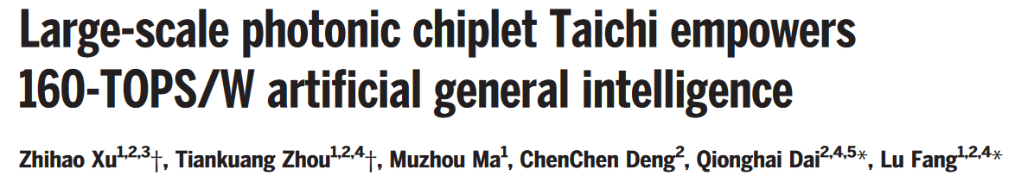
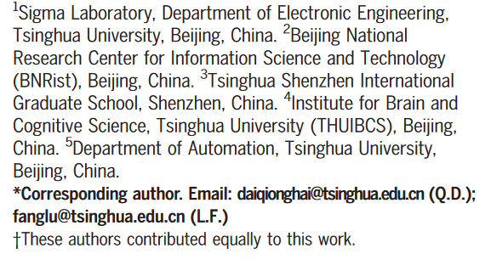
Paper Presentation
Yazan Lampert

Slide 2
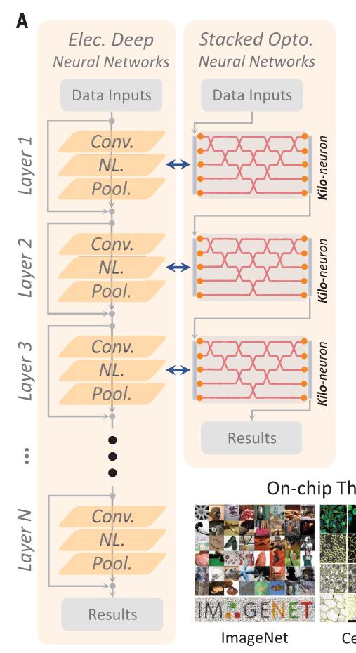
Computing architecture
compared to electronic approach, the implemented optical approach is “shallow-in-depth but broad-in-width network architecture” → large number of inputs
the work is based on diffractive elements on chip
chip based silicon photonics → dense structures compared to other platforms like Lithium Niobate

Slide 3
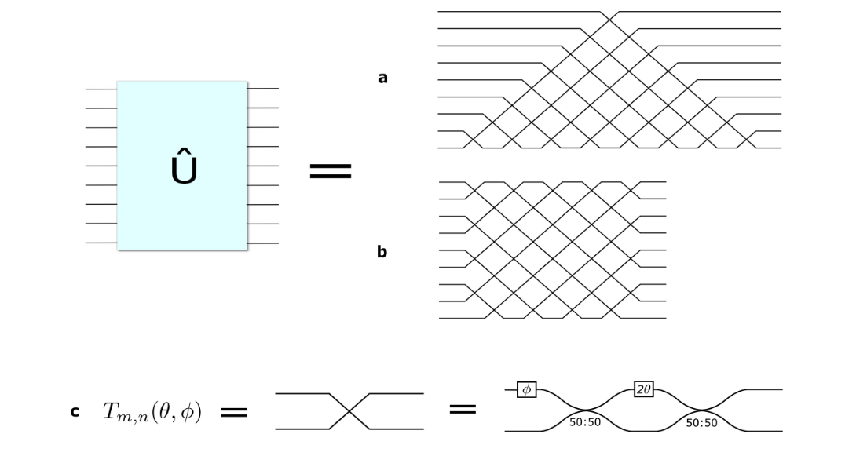
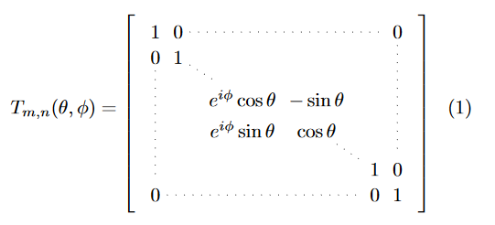
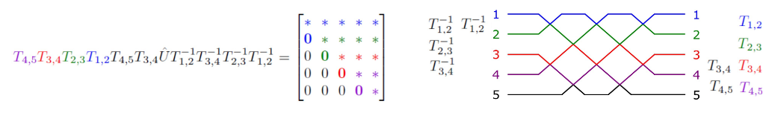
Computing architecture
optical architecture is based on : William R. Clements, Peter C. Humphreys, Benjamin J. Metcalf, W. Steven Kolthammer, and Ian A. Walmsley, "Optimal design for universal multiport interferometers," Optica 3, 1460-1465 (2016)
representation of a unitary operator with beam splitters, phase shifters, and attenuators

Slide 4
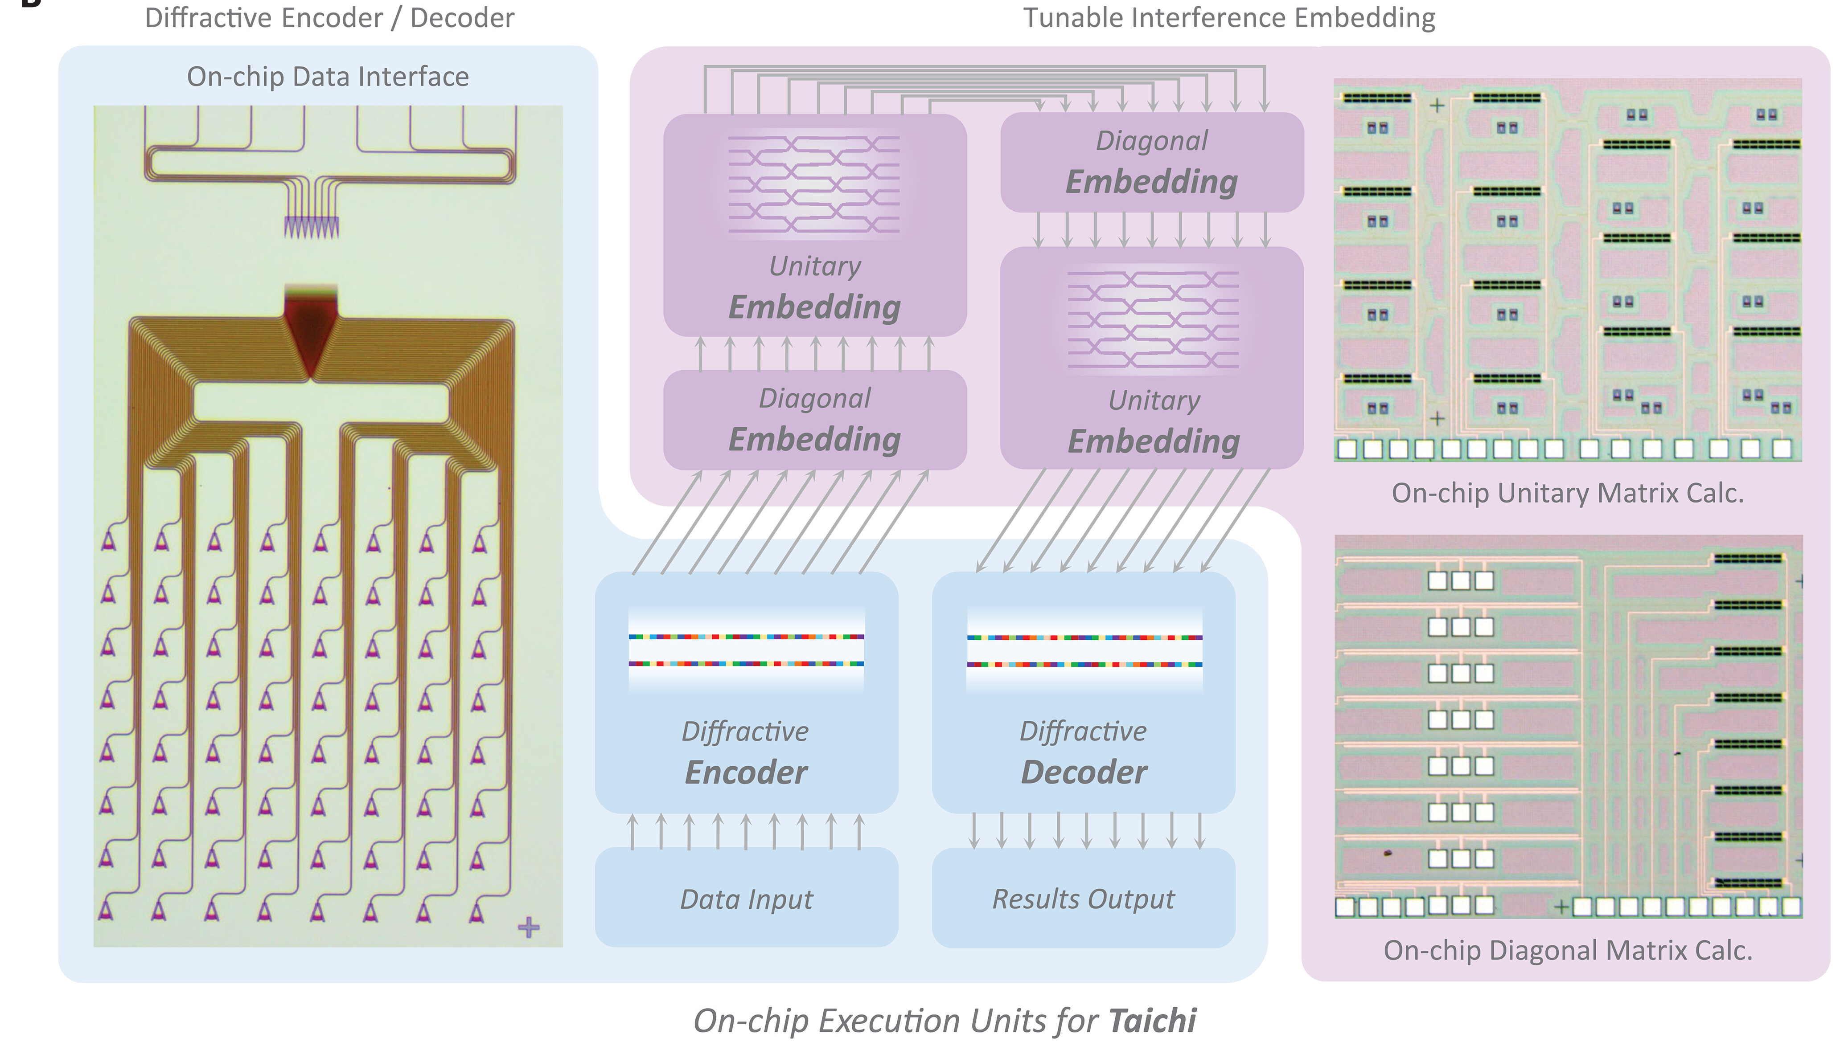
Components
the chip consists of:
encoder
matrix calculations
unitary embedding
diagonal embedding
unitary embedding
decoder
hardware wise, encoder and decoder are identical: 64x8 inputs/outputs

Slide 5
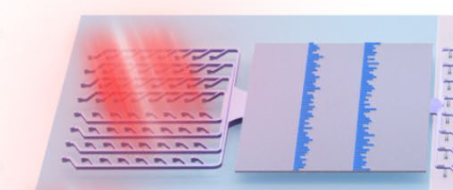
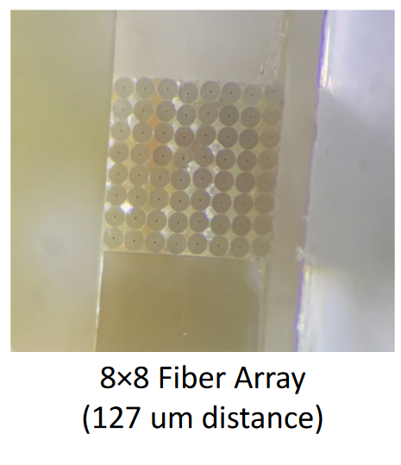
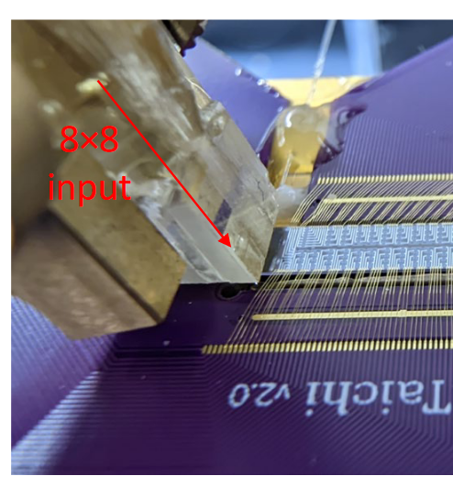
Components – encoder
64 grating couplers with specified distance of 127 um

Slide 6
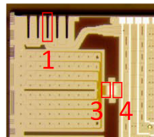
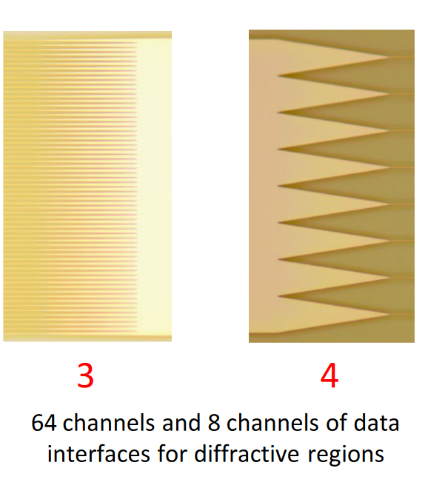
Components – encoder
64 grating couplers with specified distance of 127 um
input waveguides: 100 μm of width and 128 μm of height go through 64 tapers (50 μm of length and 2 μm of height
diffractive weights are mapped to length of slots
The diffractive encoding results will be received by 8 tapers (50 μm of length and 16 μm of height)

Slide 7
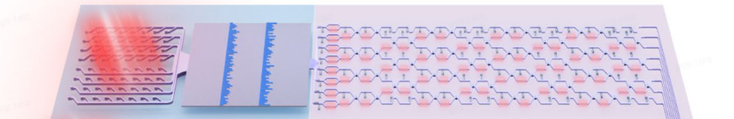
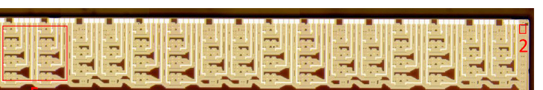
Components – interference feature embedding

Slide 8
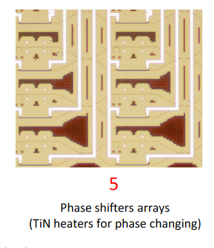
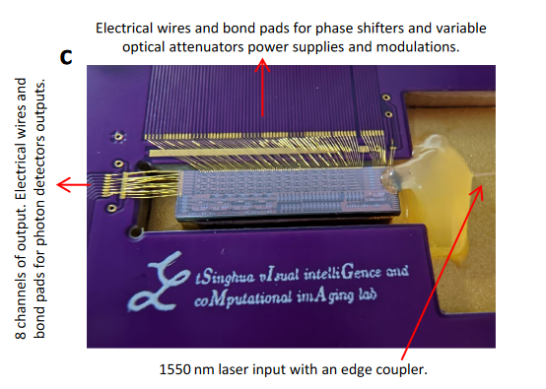
Components – interference feature embedding

Slide 9
Components – interference feature embedding
SVD: a matrix can be written as UDU: U is unitary matrix, D is diagonal matrix
reconfigurable interference embedding w/ 8 by 8 unitary matrix multiplication: 56 phase shifters
phase shifters: heaters with 320 μm vertical and 660 μm horizontal distances
electrical power supply: only 4 phase shifters share signal and ground
black trenches to decrease cross-talk

Slide 10
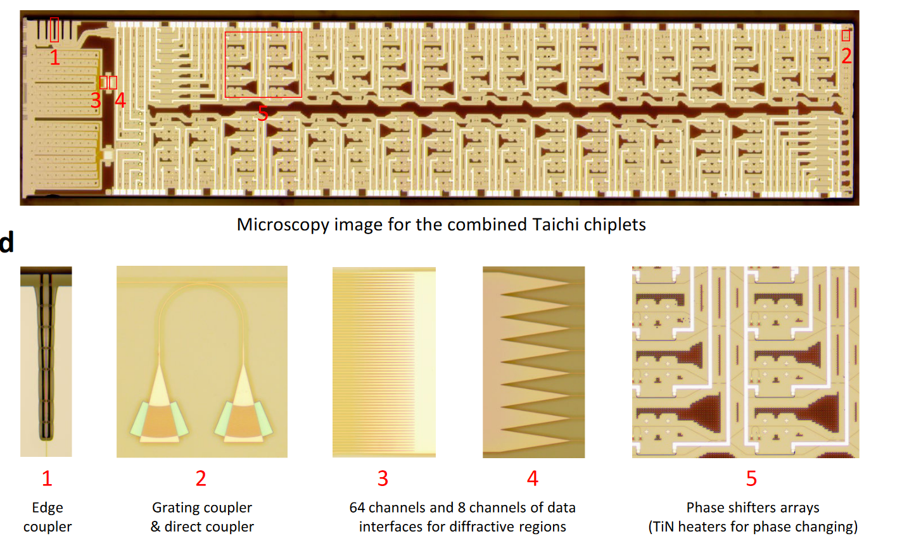
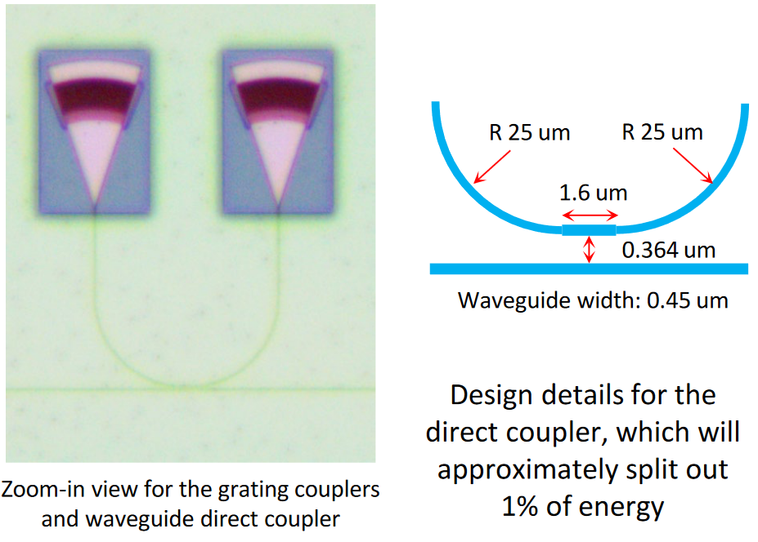
Components – data readout

Slide 11
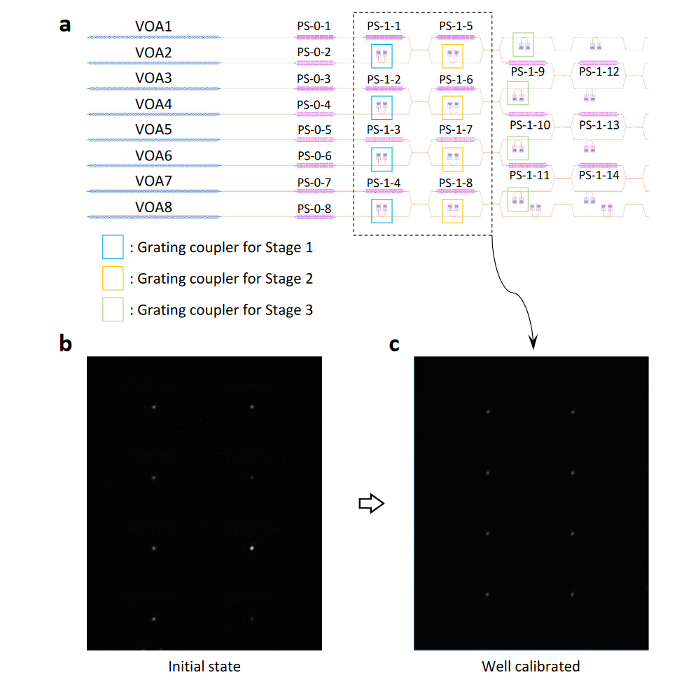
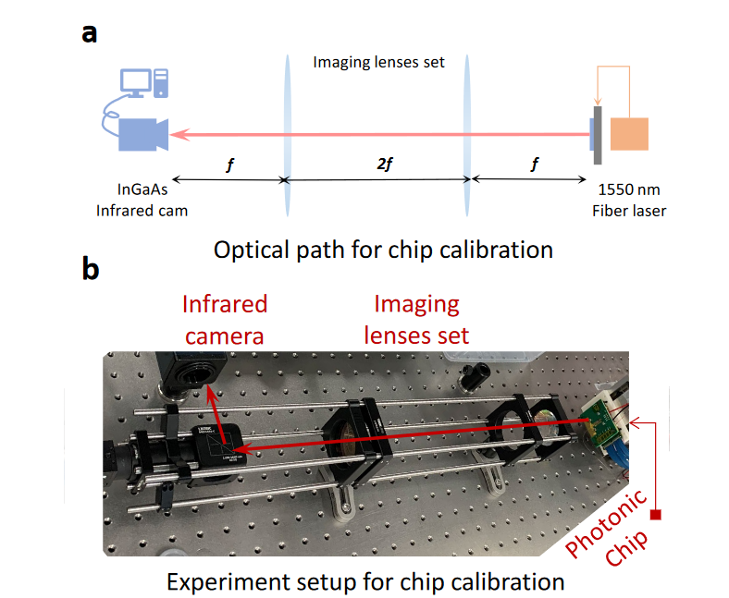
Components – calibration
1% of light is coupled to grating couplers and light is collected by IR camera
3 stages for calibration and using phase shifters and variable optical attenuators VAO

Slide 12
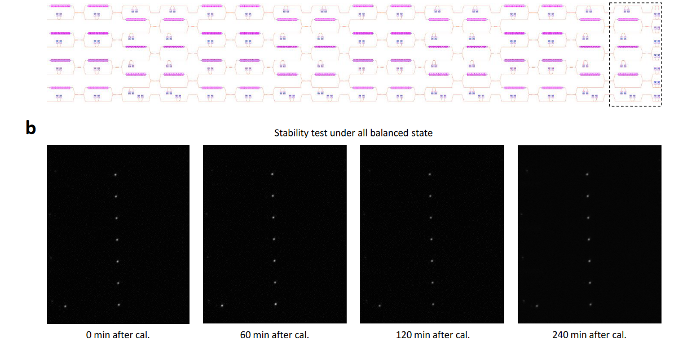
Stability over time
Problem: during operation, the heaters will change the whole temperature of the chip and ruin calibration → temperature controller was needed
With the temperature controller, calibration is maintained over 4 hours

Slide 13
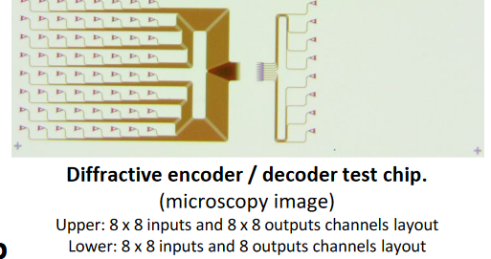
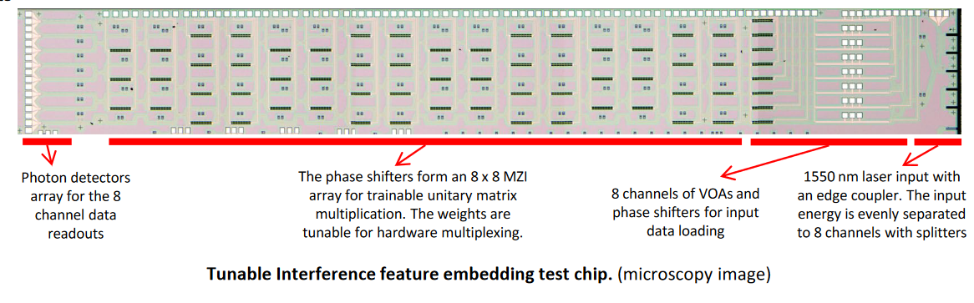
Prototypes
encoder/decoder and interference feature embedding were tested separated before the final chip

Slide 14
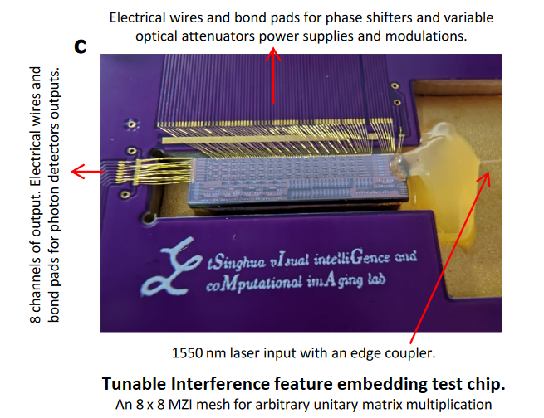
Prototypes

Slide 15
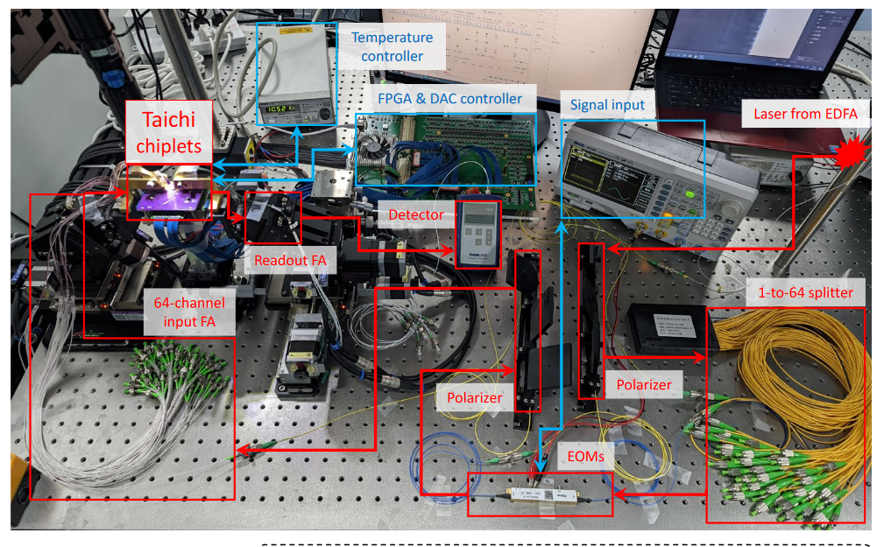
Optical setup

Slide 16
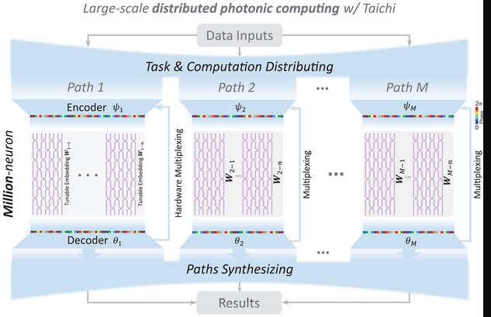
Distributed computing architecture
in each path, 7 layers max
the “path” is defined by using the same chip but different weights

Slide 17
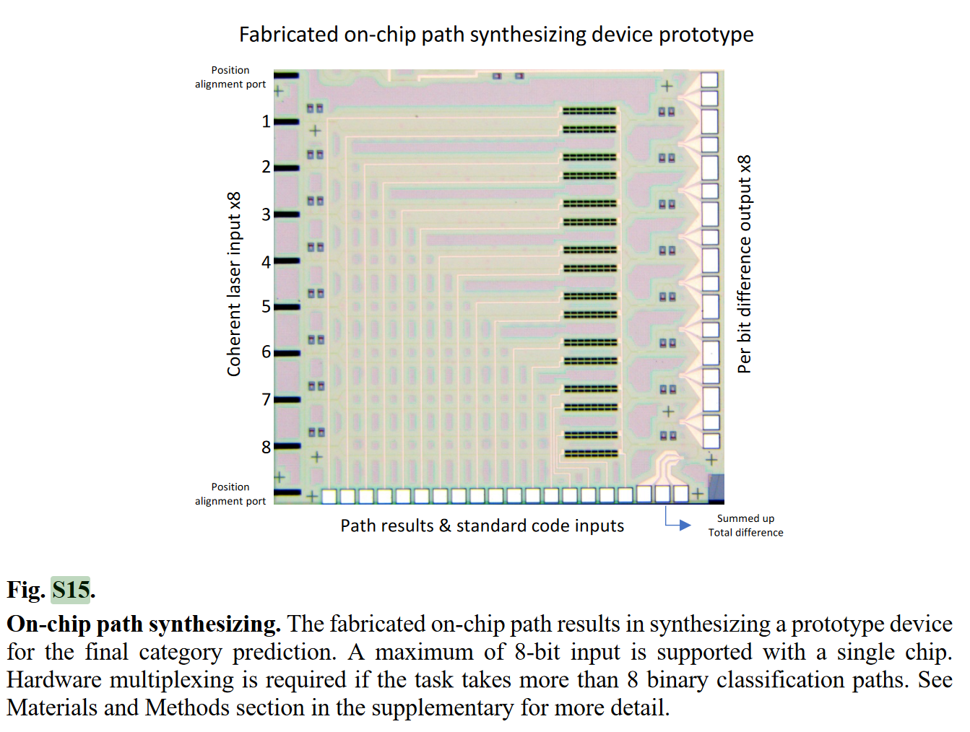
Distributed computing architecture
in each path, 7 layers max
the “path” is defined by using the same chip but different weights
not clear:
In the prototype path
synthesizing chip, a maximum of 8 paths could be processed simultaneously. However, for more
paths, we can multiplex the same hardware several times to extend the path capacity.

Slide 18
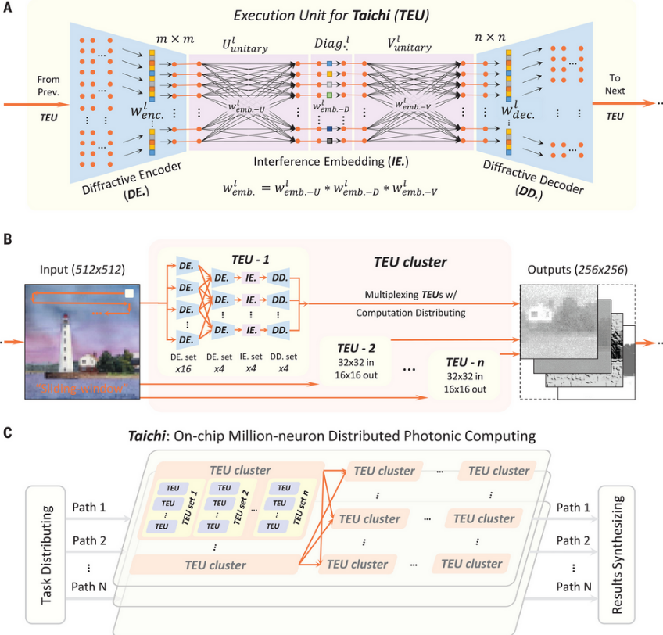
Taichi
sliding window for larger inputs
complex tasks are decomposed as multiple simple tasks, and each simple task is handled with a series of TEU clusters (marked as a “path”)
a TEU is a device with a given weights distribution → when moving from TEU-1 to TEU-2 only the weights will be changed

Slide 19
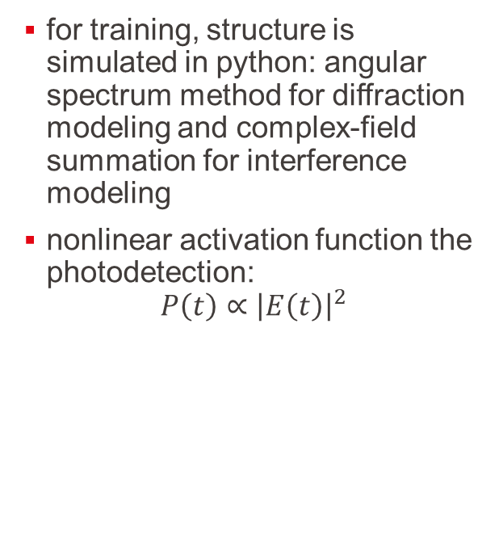
Taichi
for training, structure is simulated in python: angular spectrum method for diffraction modeling and complex-field summation for interference modeling
nonlinear activation function the photodetection:
$$P\left(t\right)∝{\left|E\left(t\right)\right|}^{2}$$

Slide 20
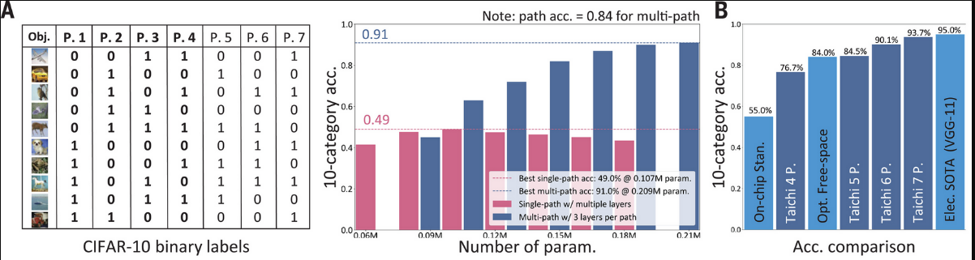
CIFAR-10 dataset
single path is the “conventional” computing
they show using CIFAR-10 dataset that multipath can reach higher accuracy
the single-path network: each layer consisted of 16.8 thousand parameters, and with fewer than six layers
Multipath: each path had 20.9 thousand parameters and three layers to match the total parameter scale with the single-path one

Slide 21
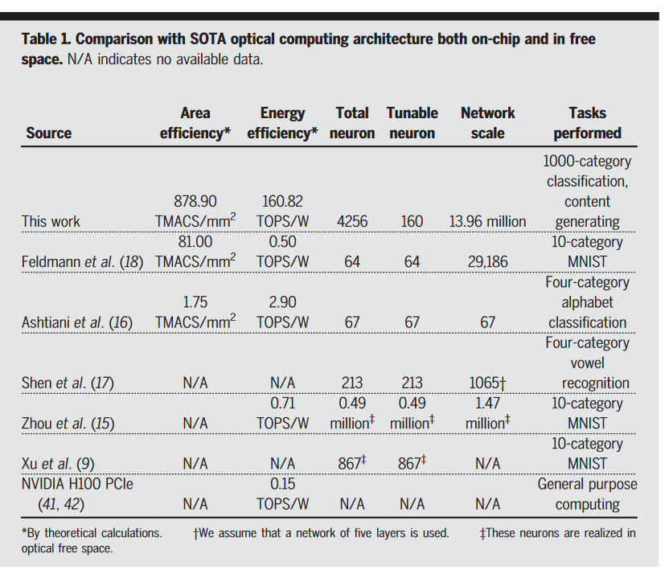
Comparison
“In energy efficiency calculation, the power consumptions for peripheral devices (a total of 260.32 Watts as listed above), and the on-chip power consumptions are counted”

